Slide 1

Creators and Innovators
By the team that‘s good at nothing but shitposting
(yes, not even at naming projects)
(Jakob Fuchs, Oleksandr Makhmudov, Hanna Lib)

Slide 2
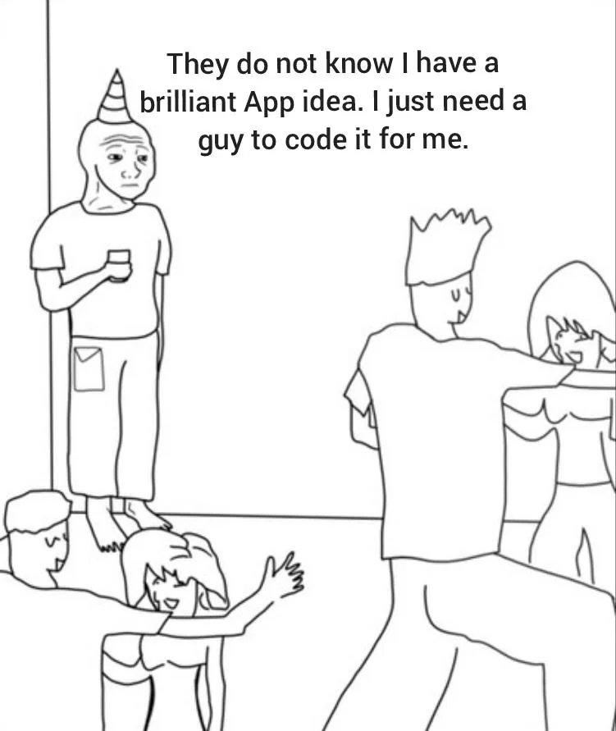
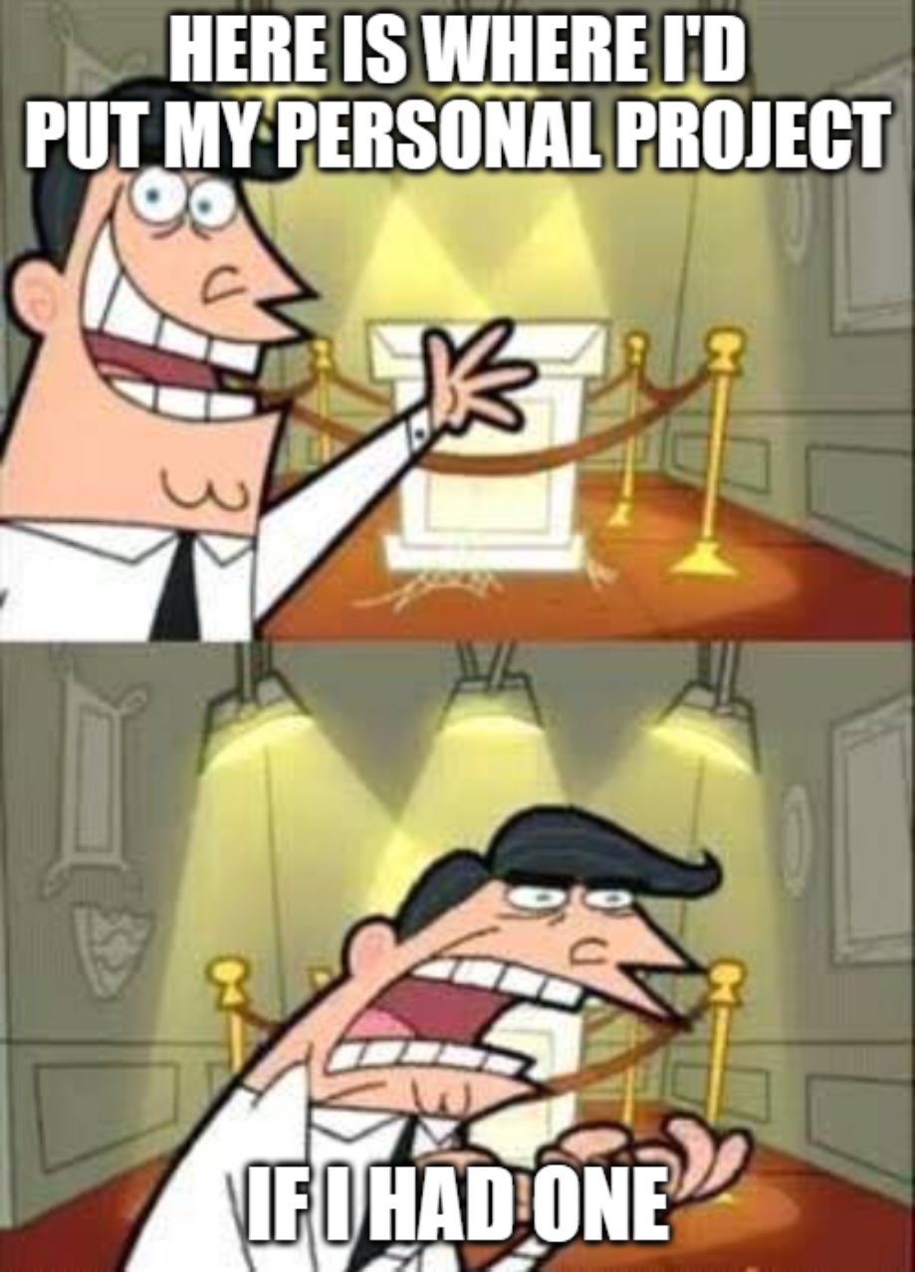
Introduction – The Problem
On one side:
People with amazing ideas, who lack skills to implement them (Innovators)
On the other side:
Skilled people who do not have a project to work on (Creators)
https://www.reddit.com/r/ProgrammerHumor/comments/12hat4s/wojak_has_an_idea/

Slide 3
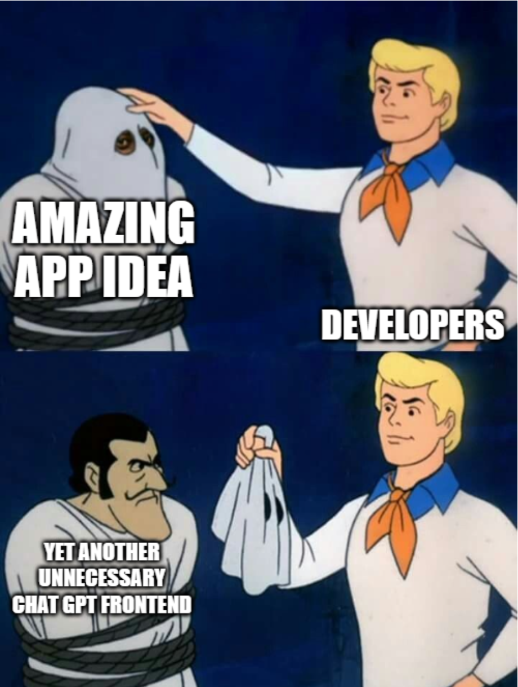
Introduction – The Problem II
Ideas are oftentimes not as good as the person who had the ideas believes.
Creators have a hard time sifting through the mediocre ideas to find one that actually has potential.
(Hanna with imgflip)

Slide 4
The Solution?
Our own amazing app idea ;)

Slide 5
The Solution – Our App
- helps both Creators and Innovators
- helps Innovators formulate their Ideas in a way that will make finding people with the right skills set to make their dream become a reality with the help of an AI integration (at least in theory lol)
- gives Creators the opportunity to look through Ideas while helping fellow Creators find good ideas faster

Slide 6
The Solution – Our App
Creator Interface:
- Presents ideas
Provides you with 3 options:
- ask to help
- upvote
- downvote
Why the up/downvote?
- Algorithm helps upvoted ideas (-> ideas with more potential) get more views
- Algorithm pushes ideas with no potential down to waste less Creators‘ time

Slide 7
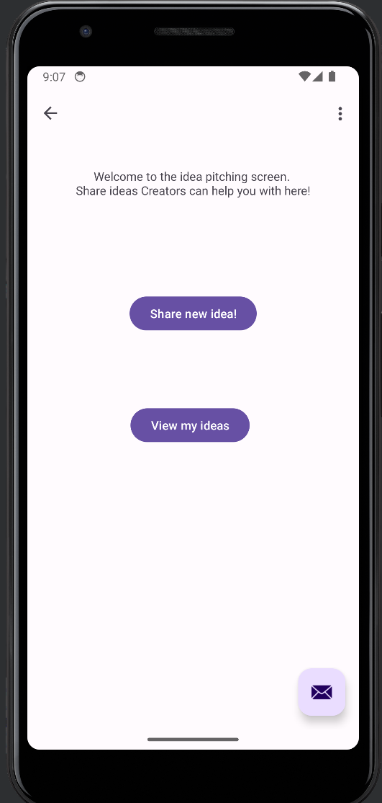
The Solution – Our app
Innovator Interface:
- View past ideas
- Pitch new ideas (with the help of AI™)
- Chat with Creators interested in implementing your Ideas
(Screenshot Android Studio – Hanna)

Slide 8
Thank you for your attention :D
(Hanna sadly ran out of time for more slides ☹)
Make sure to check our project out on GitHub!
Feel free to ask any questions you have :D

